Slide 1
Gestalt Principles of Visual Perception
Data Visualization
John F. Tripp

Slide 2
Visual Perception Principles
To this point, we have discussed perception principles related to one visualization.
However, in modern BI dashboards, we often need multiple visualizations to “work together”.

Slide 3
Visual Perception Principles
Gestalt school of psychology
  Proximity
  Similarity
  Enclosure
  Closure
  Continuity
  Connection
Once you are working with multiple visualizations, you need to pay attention to these things.

Slide 4
Notes:
The perception of grouping produced by connection is stronger than that
produced by proximity or similarity (color, size, and shape); it is weaker only than that produced by
enclosure. The principle of connection is especially useful for tying together non‐quantitative datafor
example, to represent relationships between steps in a process or between employees in an organization.

Slide 5
Notes:
The perception of grouping produced by connection is stronger than that
produced by proximity or similarity (color, size, and shape); it is weaker only than that produced by
enclosure. The principle of connection is especially useful for tying together non‐quantitative datafor
example, to represent relationships between steps in a process or between employees in an organization.

Slide 6
Notes:
The perception of grouping produced by connection is stronger than that
produced by proximity or similarity (color, size, and shape); it is weaker only than that produced by
enclosure. The principle of connection is especially useful for tying together non‐quantitative datafor
example, to represent relationships between steps in a process or between employees in an organization.

Slide 7
Notes:
The perception of grouping produced by connection is stronger than that
produced by proximity or similarity (color, size, and shape); it is weaker only than that produced by
enclosure. The principle of connection is especially useful for tying together non‐quantitative datafor
example, to represent relationships between steps in a process or between employees in an organization.

Slide 8
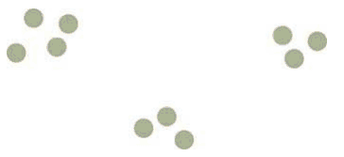
Proximity
Proximity
  Objects that “hold together” are perceived to be in groups.
    Most important driver of this is white space
  Your choice of scale will influence the amount of white space available
    Ensure that the groups have enough distance to be distinguishable as “different”

Slide 9
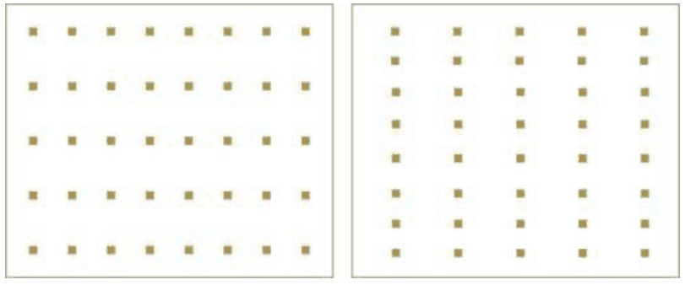
Proximity
Proximity
  This same principle in play:

Slide 10
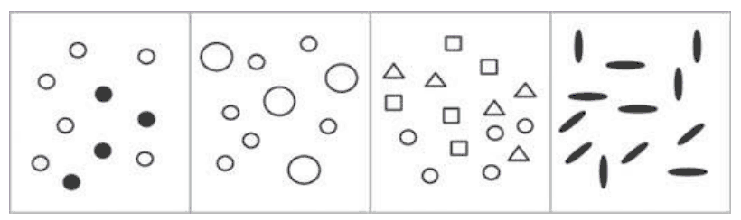
Similarity
Simply stated – when things look alike they are perceived alike
  You can modify the shape, color, size, etc. of your objects in Tableau to drive the eye to recognize what really IS similar, and what is NOT.

Slide 11
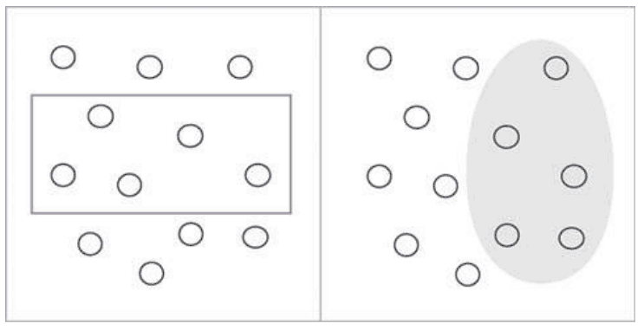
Enclosure
We perceive a set of objects to be a “group” when they are enclosed in any visual area that places a border around them.
The data points in both pictures are arranged identically, but they are perceived as being grouped very differently

Slide 12
Enclosure
Tools will allow you to create arbitrary boundaries.
(You can do this with an annotation in Tableau)
The data points in both pictures are arranged identically, but they are perceived as being grouped very differently

Slide 13
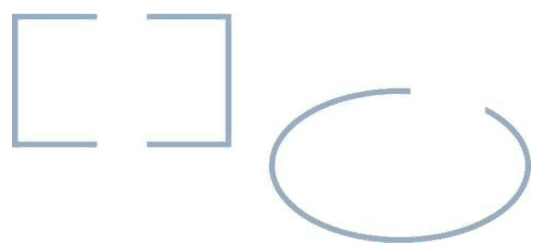
Closure
Human perception doesn’t like “loose ends”.

Slide 14
Closure
Human perception doesn’t like “loose ends”.

Slide 15
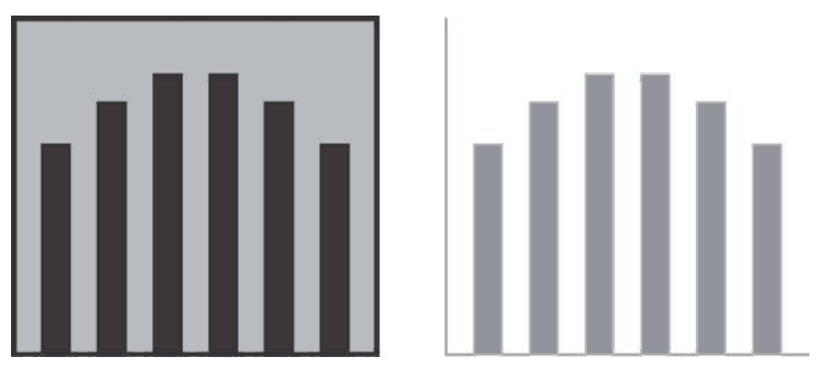
Closure
Because of this, you don’t need as much ink to separate different components on a visualization
Notes:
Humans have a keen dislike for loose ends. When faced with ambiguous visual stimuli objects that could be perceived either as open, incomplete, and unusual forms or as closed, whole, and regular forms we
naturally perceive them as the latter. The principle of closure asserts that we perceive open structures as
closed, complete, and regular whenever there is a way that we can reasonably do so.
We can apply this tendency to perceive whole structures in dashboards, especially in the design of graphs.
For example, we can group objects (points, lines, or bars in a graph, etc.) into visual regions without the use
of complete borders or background colors to define the space. This is preferable, because the need to
display a large collection of data in a small amount of space requires that we eliminate all visual content
that is not absolutely necessary, to avoid clutter. As shown here, it is sufficient to define the area
of a graph through the use of a single set of X and Y axes, rather than by lines that form a complete
rectangle around the graph, with or without a fill color.

Slide 16
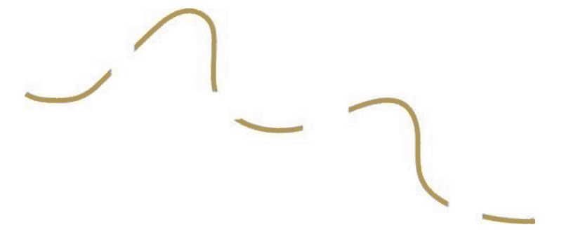
Continuity
Alignment allows for the perception of continuity
Notes:
We perceive objects as belonging together, as part of a single whole, if they are aligned with one another or
appear to form a continuation of one another. For instance, we tend to see the individual
lines as a continuation of one another, more as a dashed line than separate lines.

Slide 17
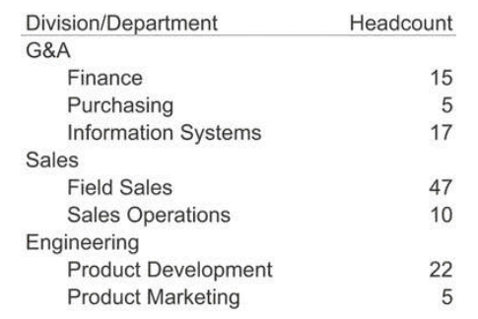
Continuity
Alignment allows for the perception of continuity
Notes:
Things that are aligned with one another appear to belong to the same group. In the table it
is obvious which items are division names and which are department names, based on their distinct
alignment. Divisions, departments, and headcounts are clearly grouped, without any need for vertical grid
lines to delineate them. Even though the division and department columns overlap with no white space in
between, their distinct alignment alone makes them easy to distinguish. This same technique can be used
to tie together separate sections of data on a dashboard.

Slide 18
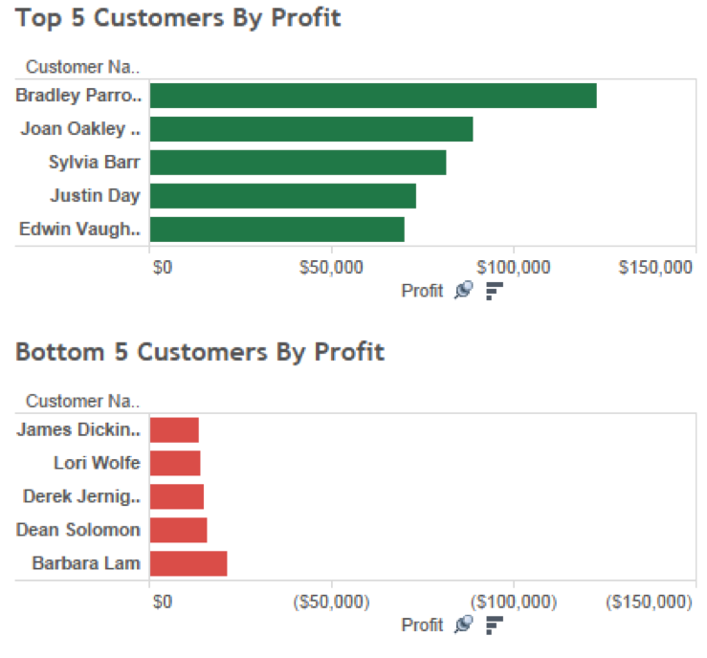

Slide 19
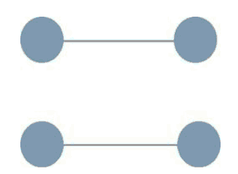
Connection
When things are connected, they are part of the same “group” (chunk).
  In this case, connection overrules proximity
Notes:
We perceive objects that are connected in some way, such as by a line, as part of the same group. even though the circles are nearer to one another vertically than horizontally, the lines that connect
them create a clear perception of two horizontally attached pairs.

Slide 20
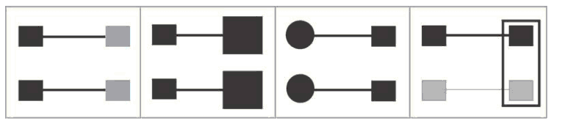
Connection
Notice how each of the principles drives the perception of “grouping”
Notes:
The perception of grouping produced by connection is stronger than that
produced by proximity or similarity (color, size, and shape); it is weaker only than that produced by
enclosure. The principle of connection is especially useful for tying together non‐quantitative datafor
example, to represent relationships between steps in a process or between employees in an organization.

Slide 21
Connection
Hierarchy of grouping
Enclosure
  Connection
    Similarity
      Proximity
Notes:
The perception of grouping produced by connection is stronger than that
produced by proximity or similarity (color, size, and shape); it is weaker only than that produced by
enclosure. The principle of connection is especially useful for tying together non‐quantitative datafor
example, to represent relationships between steps in a process or between employees in an organization.

Slide 22
Connection
Notice how each of the principles drives the perception of “grouping”
Notes:
The perception of grouping produced by connection is stronger than that
produced by proximity or similarity (color, size, and shape); it is weaker only than that produced by
enclosure. The principle of connection is especially useful for tying together non‐quantitative datafor
example, to represent relationships between steps in a process or between employees in an organization.

Slide 23
Connection
Notice how each of the principles drives the perception of “grouping”
Notes:
The perception of grouping produced by connection is stronger than that
produced by proximity or similarity (color, size, and shape); it is weaker only than that produced by
enclosure. The principle of connection is especially useful for tying together non‐quantitative datafor
example, to represent relationships between steps in a process or between employees in an organization.

Slide 24
Connection
Notice how each of the principles drives the perception of “grouping”
Notes:
The perception of grouping produced by connection is stronger than that
produced by proximity or similarity (color, size, and shape); it is weaker only than that produced by
enclosure. The principle of connection is especially useful for tying together non‐quantitative datafor
example, to represent relationships between steps in a process or between employees in an organization.

Slide 25
Connection
Notice how each of the principles drives the perception of “grouping”
Notes:
The perception of grouping produced by connection is stronger than that
produced by proximity or similarity (color, size, and shape); it is weaker only than that produced by
enclosure. The principle of connection is especially useful for tying together non‐quantitative datafor
example, to represent relationships between steps in a process or between employees in an organization.

Slide 26
Applying to Visualization Design
Challenge #1: Making the most important data stand out.
Challenge #2: Arranging data in a manner that makes sense.
Notes:
Two of the greatest challenges in dashboard design are to make the most important data stand out from
the rest, and to arrange what is often a great deal of disparate information in a way that makes sense, gives
it meaning, and supports its efficient perception. An understanding of the preattentive attributes of visual
perception and the Gestalt principles provides a useful conceptual foundation for facing these challenges. It
is much more helpful to understand how and why something works than to simply understand that
something works. If you understand the how and why, when you're faced with new challenges you'll be
able to determine whether or not the principles apply and how to adapt them to the new circumstances. If
you've simply been told that something works in a specific situation, you'll be stuck when faced with
conditions that are even slightly different.

Slide 27
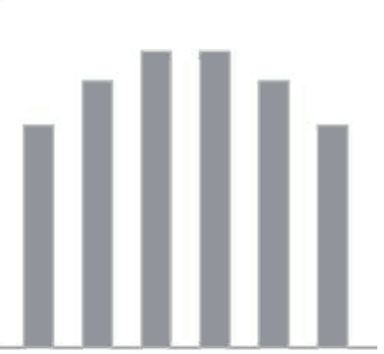
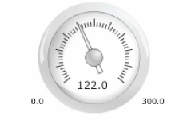

Slide 29
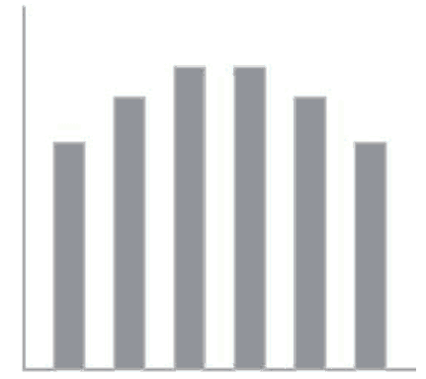

Slide 30
